Slide 1
Personalized Wallpaper suggestion system based on user profile, album preferences, gender, age & emotional status using advanced machine learning techniques.
Presented by,​
Salman F. Rahman (20301273)​
Md. Monjur E Elahe (23141076)

Slide 2
Aim
Introduction
Literature Review
Dataset Analysis
Methodology
Image recommendation system
App Screenshots
App Running Demo
Conclusion

Slide 3
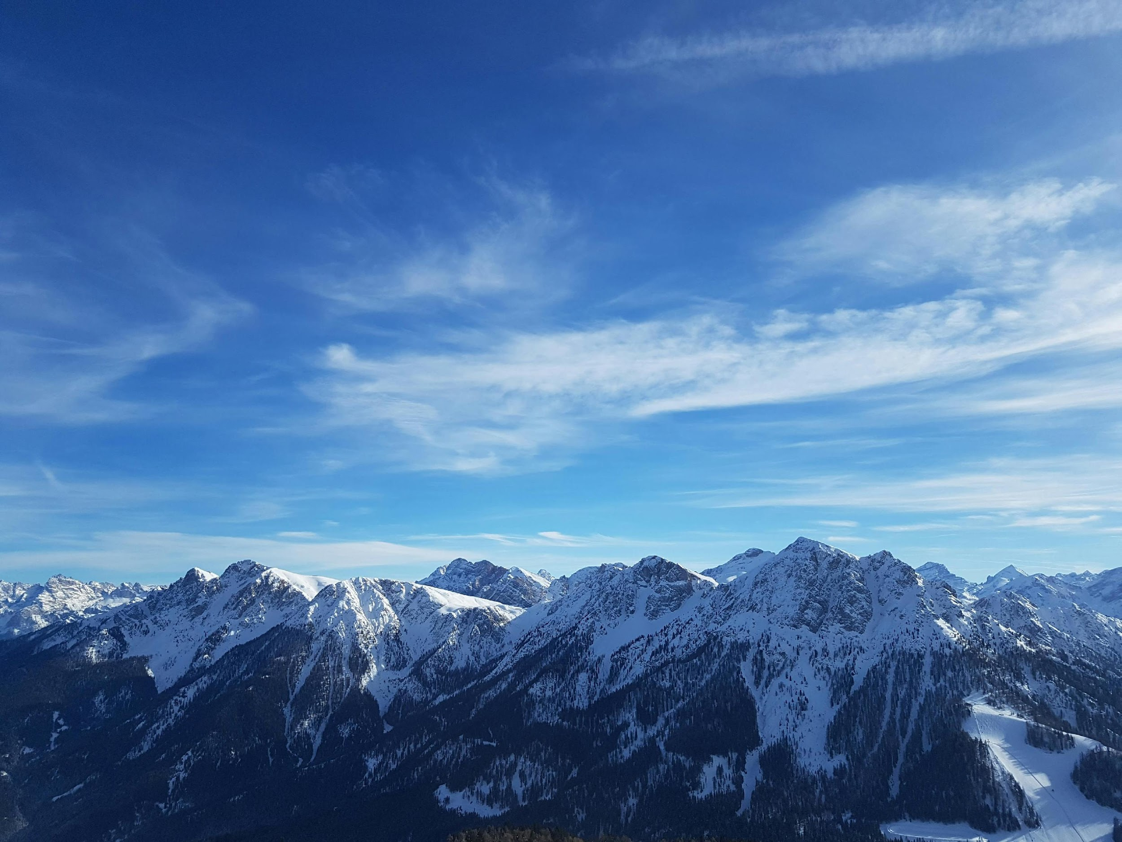
Introduction
In today's digital era, personalized experiences are in high demand, leading to the development of intelligent recommendation apps. Our Wallpaper Suggestion App (WSA) utilizes advanced machine learning techniques to cater to individual preferences, including user profile, album choices, gender, age, and emotional status. By analyzing diverse data points, such as user demographics and emotional context, the WSA enhances user engagement and satisfaction with tailored wallpaper selections. Through rigorous experimentation, we demonstrate the efficacy of our approach in delivering highly personalized recommendations, paving the way for more intelligent and empathetic user experiences in digital environments.

Slide 4
Literature Review
•Importance of Personalized Wallpaper Recommendations: Personalization enhances user experiences in digital environments by offering curated selections of images that resonate with their preferences and emotional states.
•Understanding User Psychology and Preferences: Gender, age, and emotional status significantly influence image preferences, highlighting the importance of integrating psychological insights into recommendation systems.
•Integrating Psychological Insights into Recommendation Systems: Hybrid recommendation approaches combine collaborative filtering with demographic information to personalize image recommendations based on user characteristics.
•Image Processing Techniques for Content Differentiation: Convolutional Neural Networks (CNNs) excel at classifying wallpaper images into thematic categories, enhancing the effectiveness of recommendation systems.
•Challenges and ML Models for Image Processing: ML models such as CNNs, RNNs, and GANs are employed for image processing tasks, addressing challenges related to data quality, interpretability, and scalability.
•Conclusion and Future Directions: Personalized wallpaper recommendation systems offer promising avenues for enhancing user experiences in digital environments. Future research should focus on refining recommendation algorithms, exploring novel image processing techniques, and conducting user studies to validate effectiveness.

Slide 5
Exploratory Data Analysis (EDA)]
Before Data Wrangling:
Overview of raw data sources.
Analysis of user profiles, album preferences, gender, age, and emotional states.
After data wrangling
Insights gained from cleaned and preprocessed data.

Slide 6
Methodology
1. Data Collection: Gathering user profile data, album preferences, etc.
2. Data Preprocessing: Cleaning, transforming, and encoding data.
3. Feature Engineering: Extracting relevant features for recommendation.
4. Machine Learning Models: Training models for personalized recommendation.
5. Recommendation Engine: Deploying the recommendation system.

Slide 7
Partially Working Prototype
Demonstration: Display screenshots or UI mockups of the prototype.
Functionality: Overview of features implemented in the prototype.
Feedback: Initial user feedback and improvements.

Slide 8
Future Steps
1. Model Refinement: Enhancing recommendation accuracy.
2. User Interface Enhancement: Improving user experience.
3. Scaling: Handling larger datasets and user bases.
4. Integration: Incorporating real-time user feedback for dynamic recommendations.

Slide 9
Dataset Analysis
Intel Image Classification
Context
This is image data of Natural Scenes around the world.
Content
This Data contains around 25k images of size 150x150 distributed under 6 categories. {'buildings' -> 0, 'forest' -> 1, 'glacier' -> 2, 'mountain' -> 3, 'sea' -> 4, 'street' -> 5 }
The Train, Test and Prediction data is separated in each zip files. There are around 14k images in Train, 3k in Test and 7k in Prediction. This data was initially published on https://datahack.analyticsvidhya.com by Intel

Slide 10
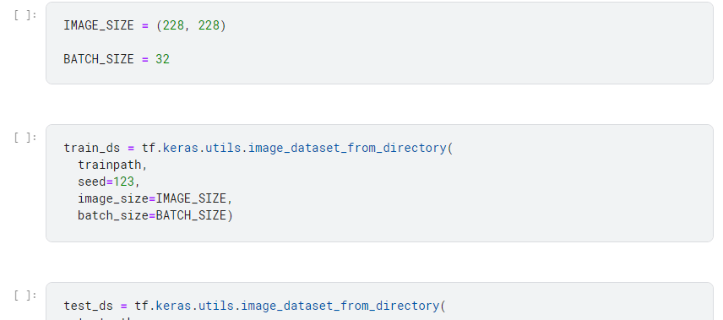
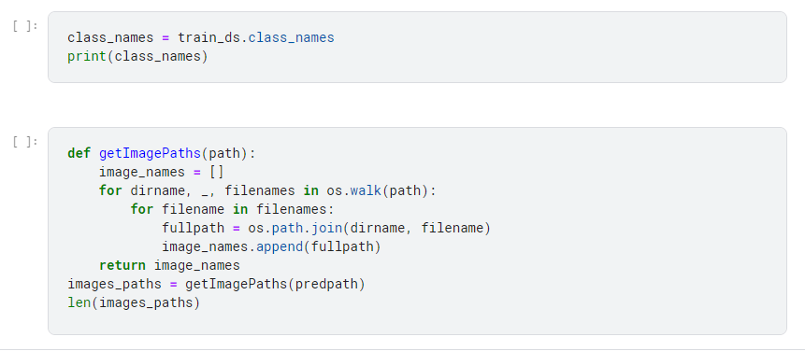
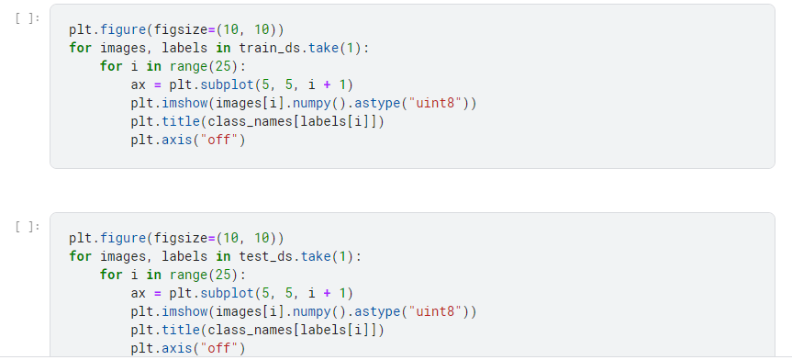
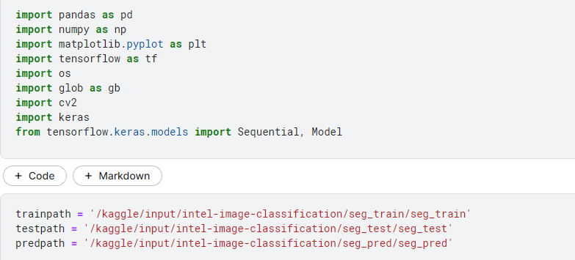

Slide 11
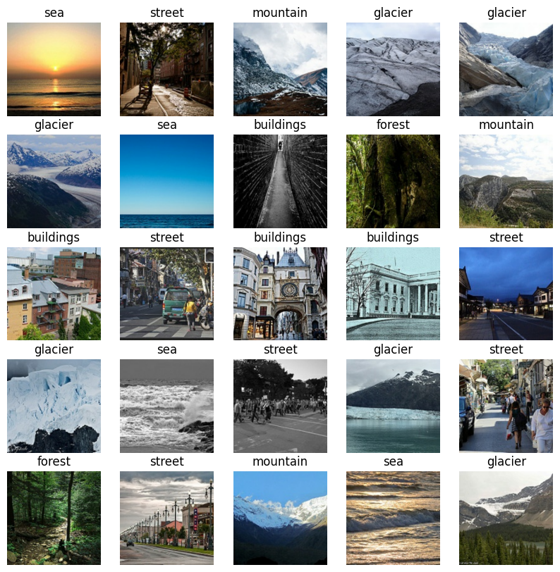

Slide 12
Image Recommendation System(App)
So, The Final Image Recommendation is a sophisticated platform designed to revolutionize the wallpaper discovery process. Leveraging advanced machine learning techniques, it analyzes user profiles, album preferences, gender, age, and emotional status to offer highly personalized wallpaper suggestions.
At its core, the system harnesses the power of machine learning algorithms to understand and cater to individual preferences. By incorporating user demographic data such as gender and age, it tailors recommendations to align with each user's unique tastes.
Moreover, the system integrates emotional analysis to recommend wallpapers that resonate with the user's current mood and feelings. This personalized approach ensures that users receive suggestions that not only match their aesthetic preferences but also reflect their emotional state.
With a focus on user-centric features and advanced machine learning, the Image Recommendation System provides a seamless and intuitive wallpaper discovery experience\cite{b59}. By leveraging cutting-edge technology, it enhances user satisfaction and engagement, redefining the way users explore and interact with wallpapers.

Slide 13
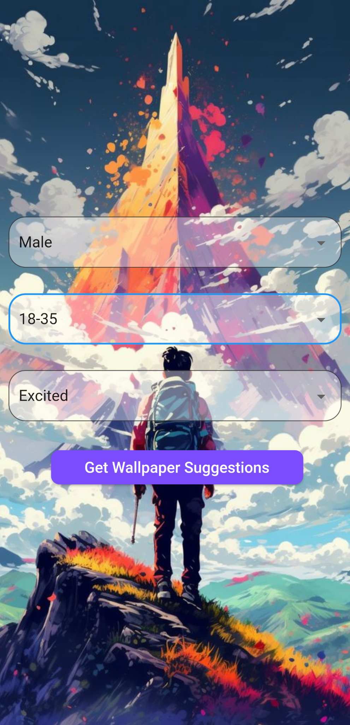
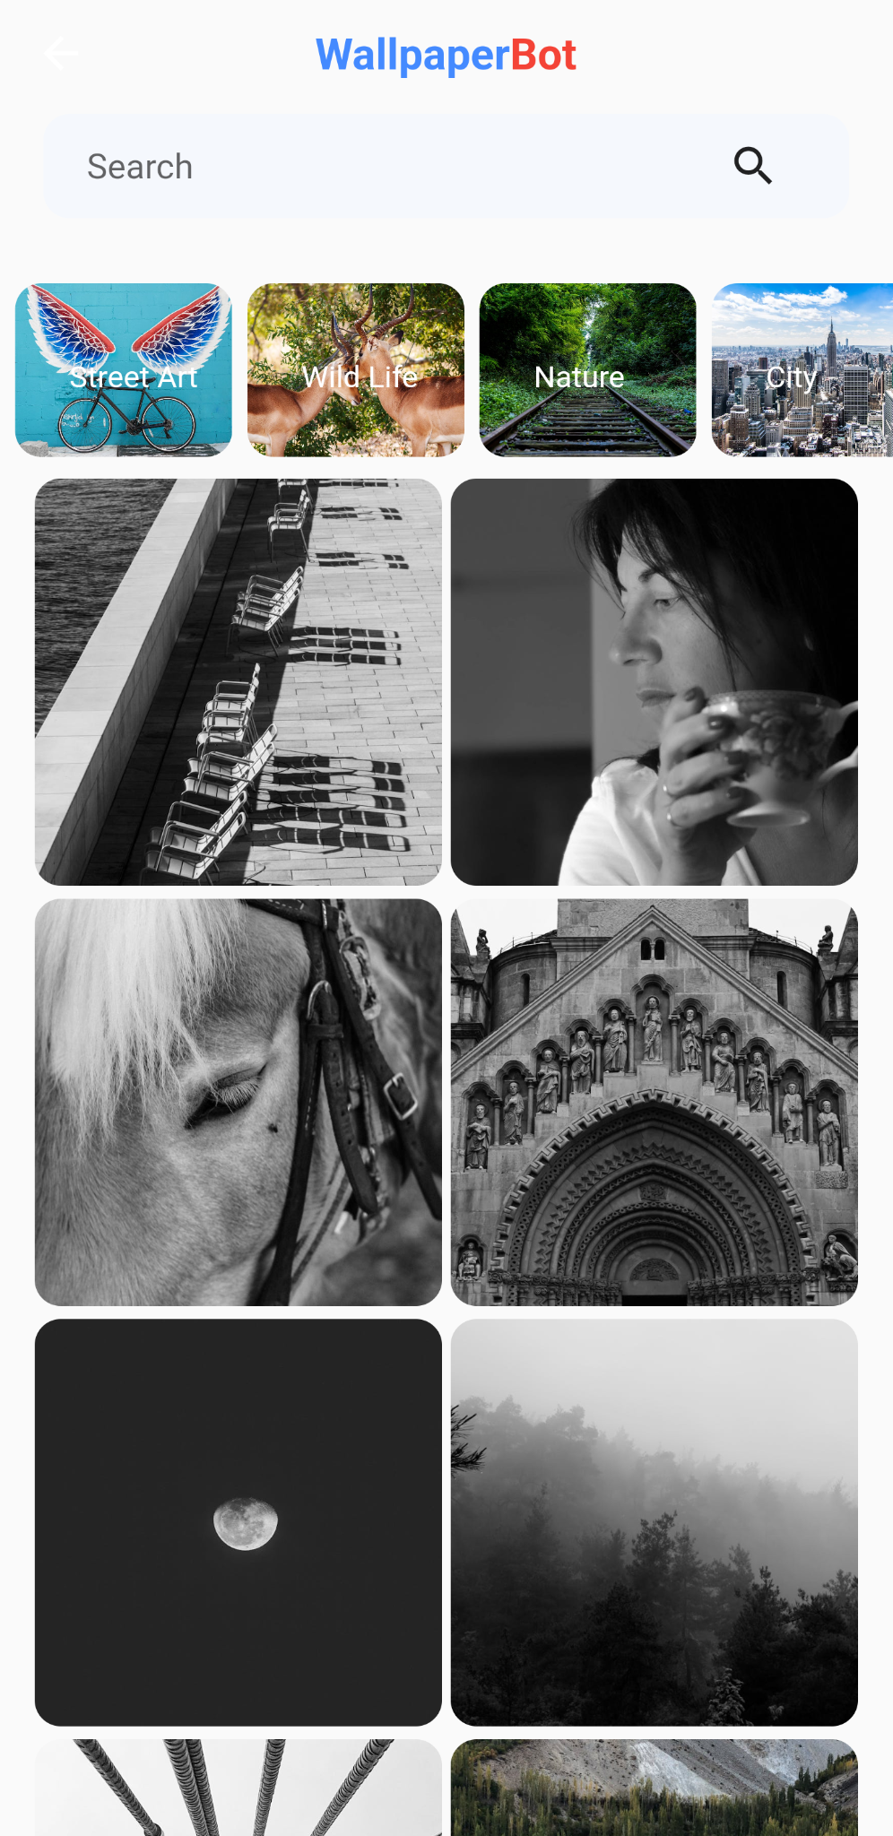
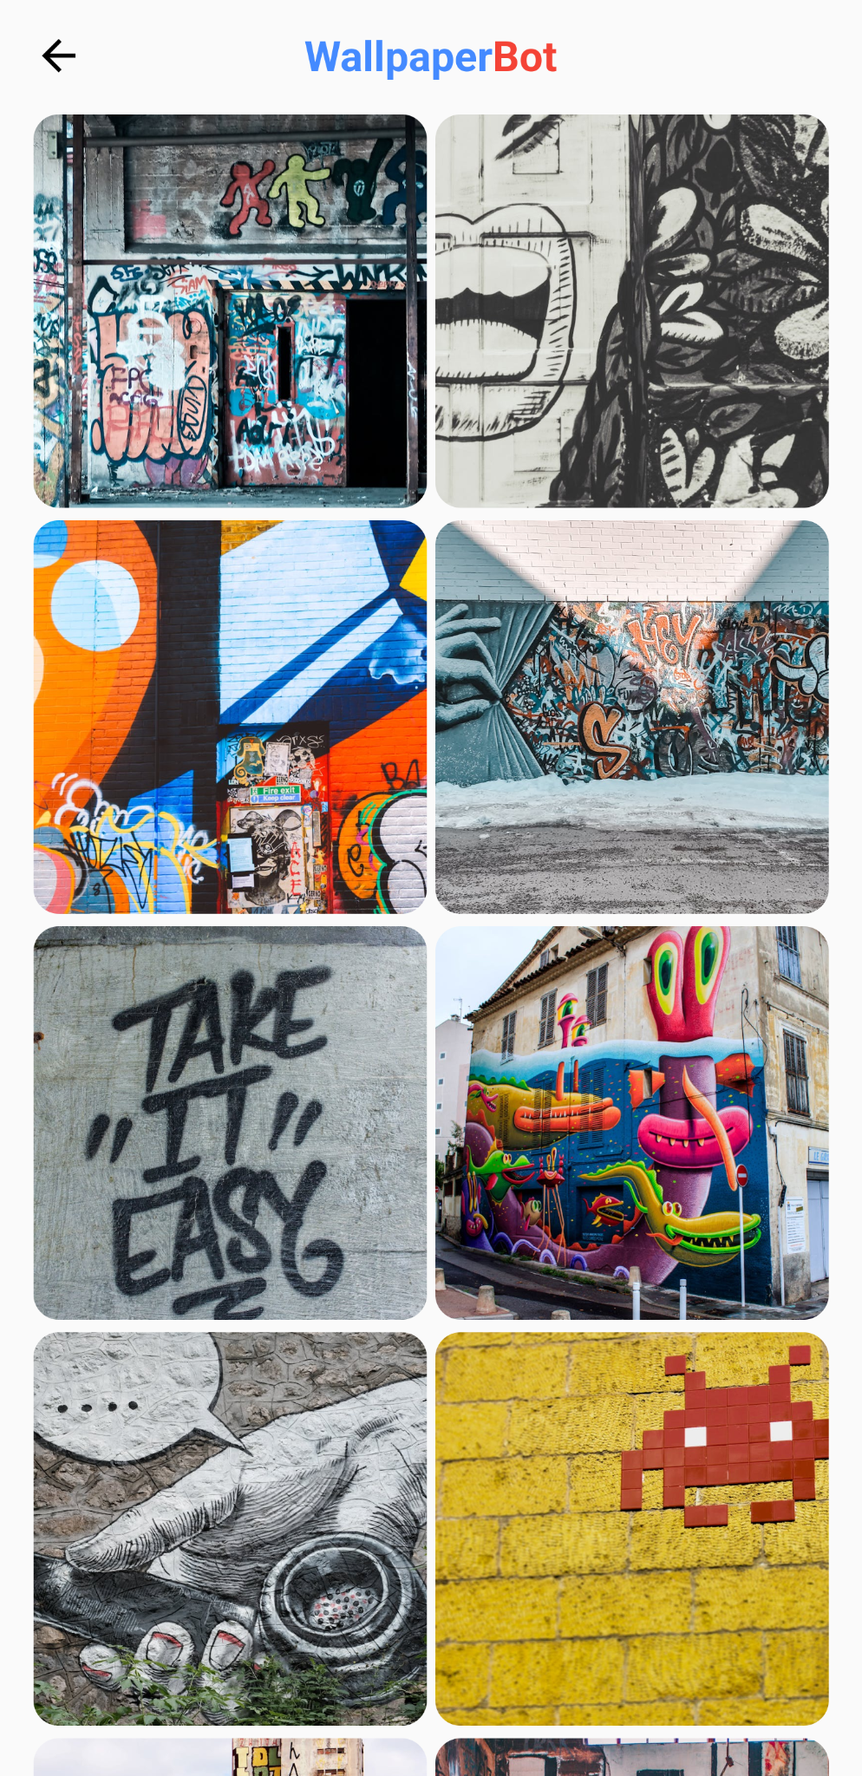
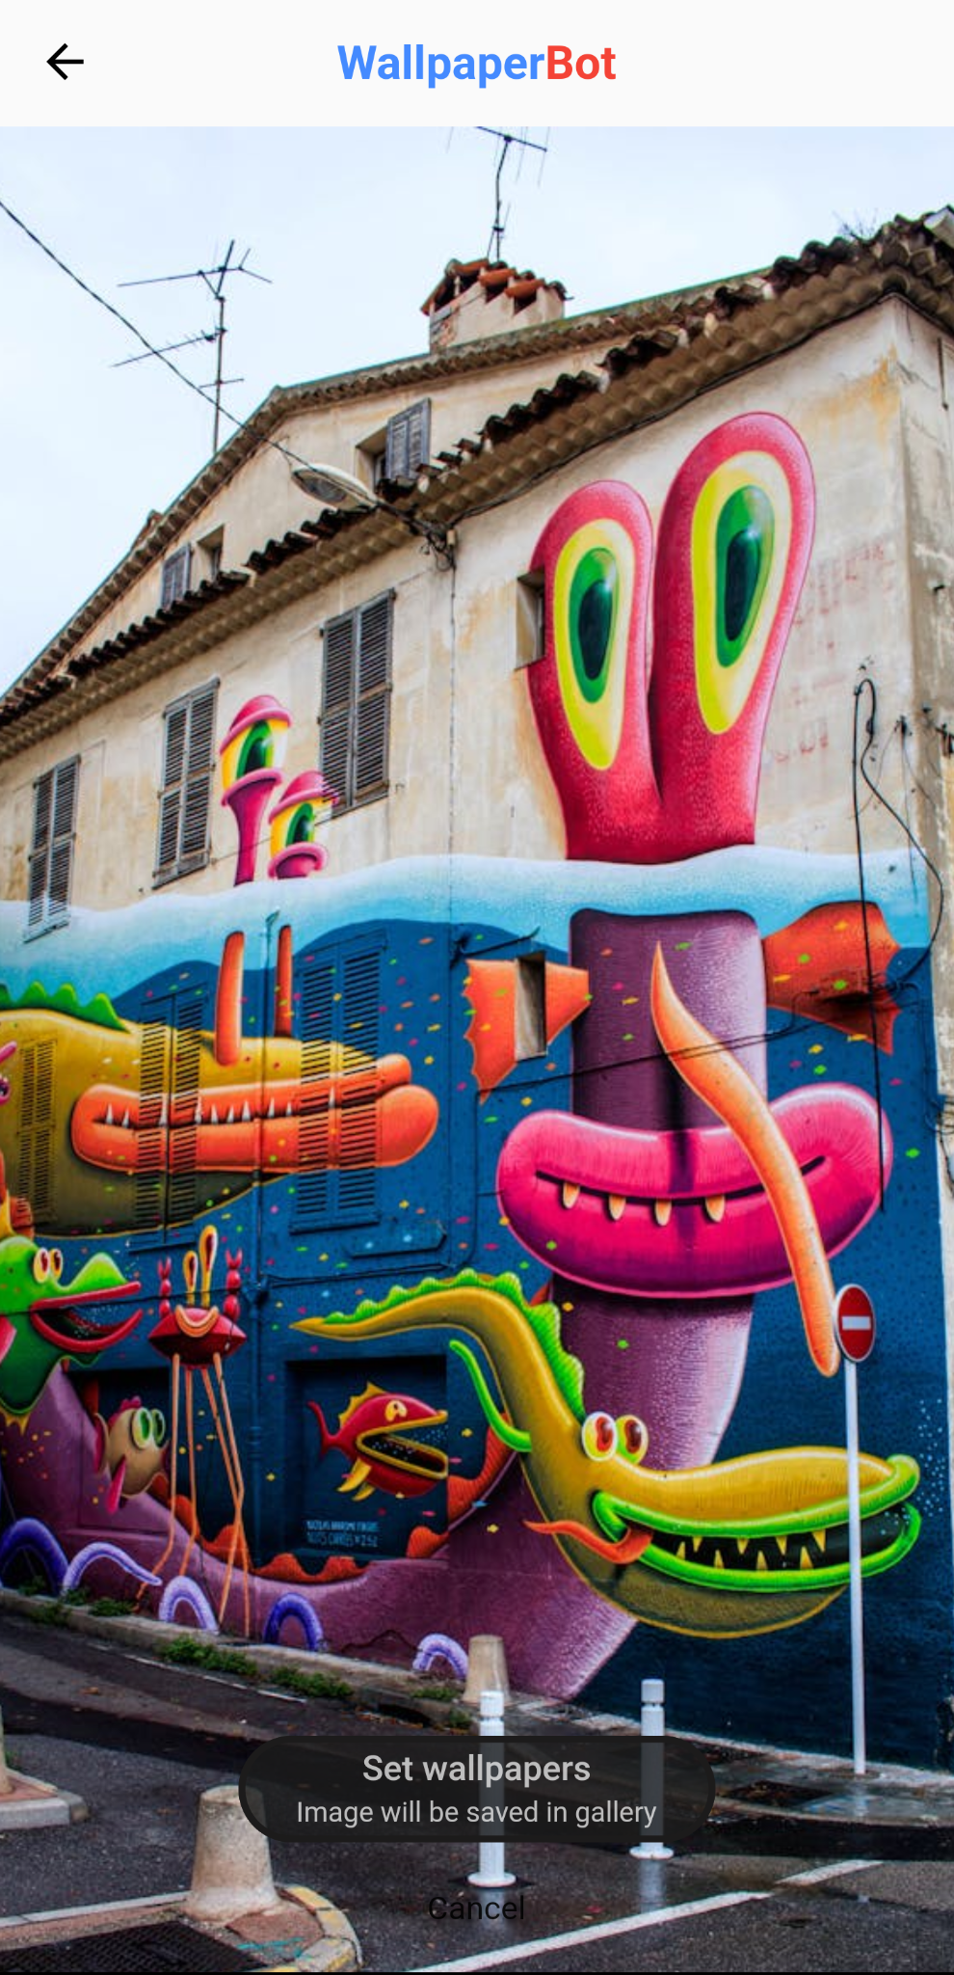
App Screenshots
1
2
3
4

Slide 14
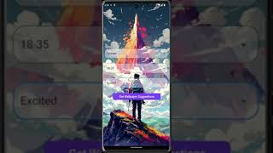

Slide 15
Conclusion
Summary: Developed a personalized wallpaper recommendation system.
Impact: Enhancing user satisfaction and engagement.
Next Steps: Continuous improvement and refinement for optimal performance.

Slide 16
Thank you

